Slide 1
For Live Session Assignment (FLS)
Unit 10

Slide 2
Quick Quiz Questions

Slide 3
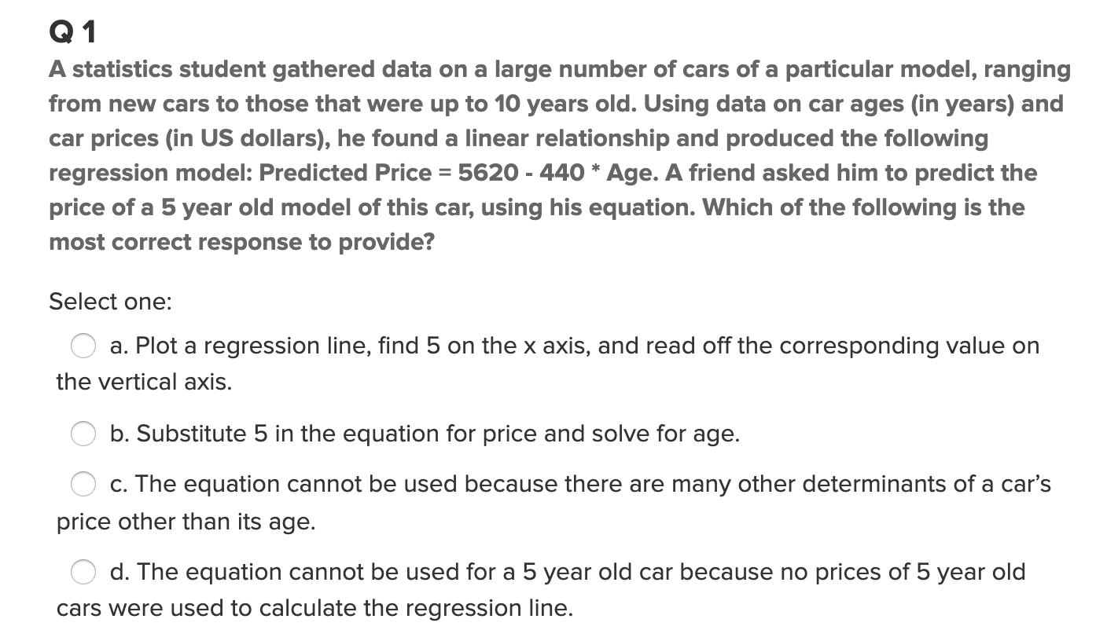
Part 1: Quick Quiz Questions

Slide 4
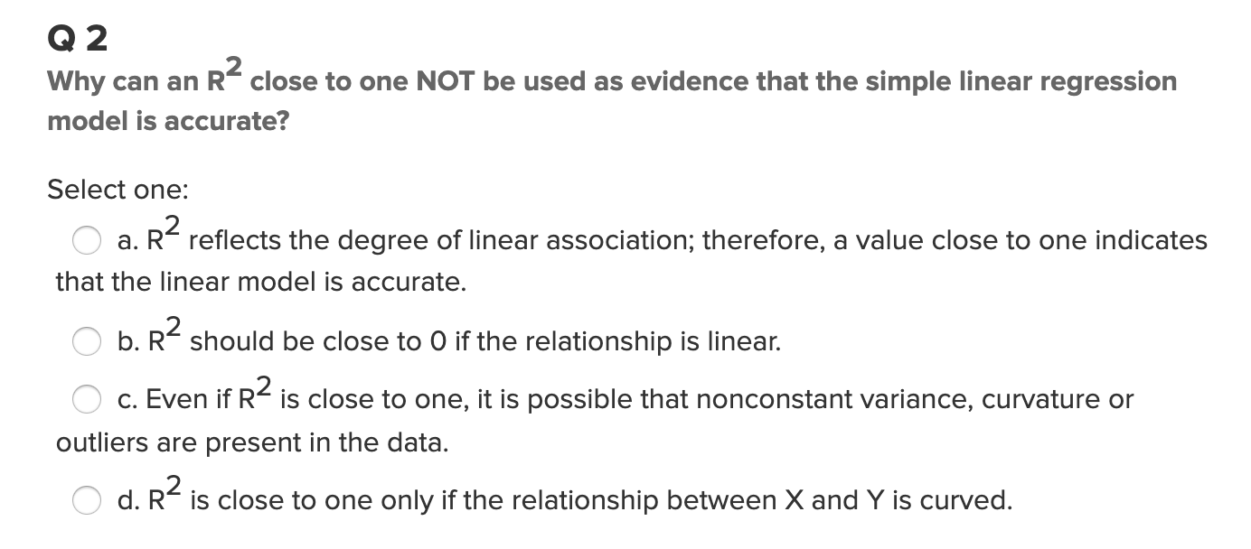
Part 1: Quick Quiz Questions

Slide 5
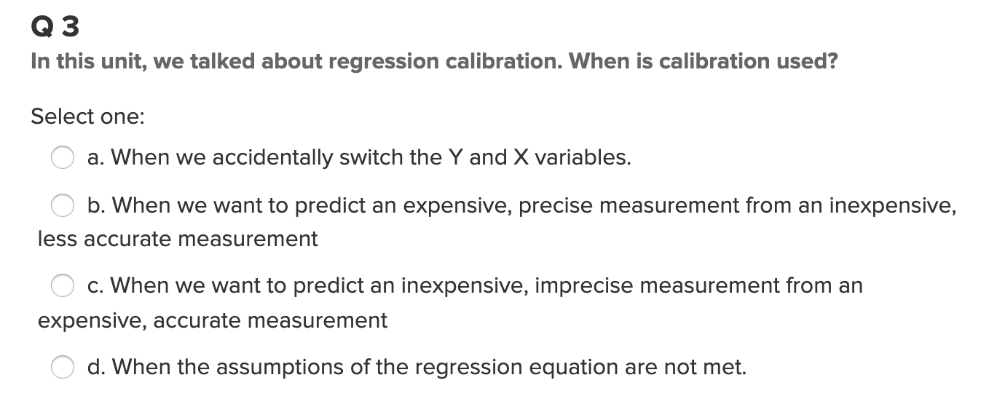
Part 1: Quick Quiz Questions

Slide 6
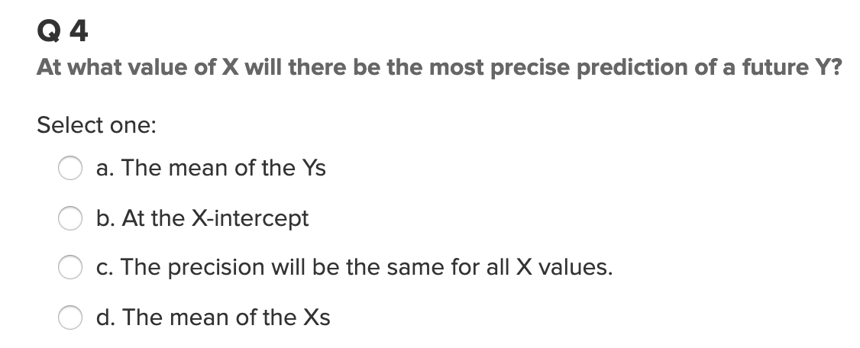
Part 1: Quick Quiz Questions

Slide 7
End Quick Quiz Questions

Slide 8
Question 1

Slide 9
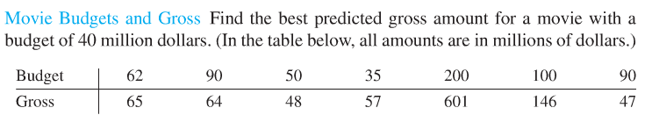

Movies
Consider the Movie Budgets and Gross data set we investigated earlier (in the Bridge Course as Well.
Please complete each step in SAS and R. This simply means to show that the statistics and calculations are the same. It does not mean that you need a different slide and write up for SAS and another one for R.
Plot the data. Does a linear relationship between Gross and Budget look reasonable?
You may assume the assumptions of linear regression are met but think about each one.
Perform a 6 step test for the slope of the regression line of Gross on Budget (Y on X) being different from zero?
Identify the estimate of the common standard deviation of the normal distributions of Gross for each Budget.
Calculate and Interpret a 95% confidence interval for the slope.
Calculate and interpret a 95% confidence interval for the the predicted mean Gross for a Budget of $95 million.
Calculate and interpret a 95% prediction interval for the the predicted mean Gross for a Budget of $200 million.
If you did not before, provide a plot with the 95% confidence and prediction intervals visible.
Next, find a 95% calibration interval for the estimated budget needed to obtain a gross of $210 million. Use both the visual and analytical methods.

Slide 10
End Question 1

Slide 11
Question 2: Takeaways!
Please provide at least 4 takeaways from this section and any questions that you may have. These questions will help design the live session for this unit.
This question will be the last question of every For Live Session Assignment. The idea is that this deck will serve as a document that you can reference in the future to remember what was covered in this section. For instance, this may come in handy for the Capstone and will hopefully become useful in your career. Most immediately, it may become handy as a quick reference for your Midterm and Final! Some students find it very useful and spend a few slides summarizing the asynch material while others learn different ways and only had the minimum 4 takeaways. Either is fine and will earn you full credit for this question.

Slide 12
Question 3: Questions!
Please provide any question or topics of discussion that came up in this Unit! These will help help us optimize our live session for maximum learning and takeaways!
This question will be the last question of every For Live Session Assignment. The idea is that this deck will serve as a document that you can reference in the future to remember what was covered in this section. For instance, this may come in handy for the Capstone and will hopefully become useful in your career. Most immediately, it may become handy as a quick reference for your Midterm and Final! Some students find it very useful and spend a few slides summarizing the asynch material while others learn different ways and only had the minimum 4 takeaways. Either is fine and will earn you full credit for this question.

Slide 13
End For Live Session Assignment Unit 9!

